Slide 1
Understanding Homeowner’s Insurance and the Underwriting Process

Slide 2
Questions to determine what type of policy to write the insured?
What type of structure is the dwelling? i.e. single family home, duplex, townhome, condominium.
Who will reside in the home? i.e. the insured, a family member, a renter.
Will a business be operated out of the home?

Slide 3
Homeowner’s Insurance
What does the policy cover?
Dwelling
Main structure
Other Structures
Detached structure, garages, pool, fences, gazebo, etc. Coverage is normally 10% to 20% of the main dwelling value. The limit can be increase, if needed.
Personal Property
Contents is a percentage of the main dwelling value insured at 50% to70% .
Loss of Use
Pays your mortgage or the ability to rent another property while your property is being repaired.
Liability
Primary home versus Rental Property
Medical Coverage
Provides coverage for people who do not reside at your home.
Optional Coverage
Limited Coverage

Slide 4
Endorsements and Customizing the Policy to the Client.
Not every homeowner’s policy is created equal. Some carriers include enhancements to the policy, while others require you to endorse the policy to meet the needs of the homeowner.
Extended Replacement Cost on Dwelling at 125%, 150% or 200%.
All Risk Personal Property versus Named Peril.
Personal Property Replacement Cost versus Actual Cash Value.
Special Limits under the home policy for Jewelry, Furs, Guns, Silverware, Antiques.

Slide 5
Underwriting the Risk
How is the dwelling value established?
Each carrier uses a cost guide similar to a Core Logic /Marshall & Swift / Boechk evaluation. The current market value of the home and land is not considered when calculating the value of the home.
What are some of the underwriting requirements if you have an older home?
Updates to the roof , plumbing, electrical and heating.
Are there certain dog breeds that are not acceptable to insurance companies?
Yes, dog bites account for 1/3rd of all homeowners claims. Certain dogs are deemed to be more aggressive to insurance underwriters. Each company has their own list of dogs: Pit Bull Terrier, Staffordshire Terrier, Rottweiler, German Shepherd, Presa Canarios, Chows, Doberman Pinscher, Akita, Wolf- Hybrid, Mastiff, Cane Corso, Great Dane, Alaskan Malamute, Siberian Huskie.

Slide 6
Underwriting the Risk (Continued)
What if the property has water losses from previous owners?
What if current buyer has a history of prior claims?
Does the insurance company inspect the property?
High Valued Homes
Can you insure properties close to brush?
Yes, as long as there is a minimum brush clearance.

Slide 7
Discounts Available
Smoke Detectors, Fire Extinguisher and Deadbolts Discount.
Central Station Burglar and Fire Alarm Discount.
Interior Sprinkler System Discount.
Multi-policy Discount
Newer Home Discount.
Claims Free Discount.
Green Home Discount.
Occupational Discount.

Slide 8
Who is the named insured?
How do you address title on the policy?
What if the homeowner wants to change the title, or creates a trust?
What happens at time of loss if the policy is not written with the correct named insured?

Slide 9
What is minimum information needed to obtain a quote?
Buyer’s Name (all parties):
Buyer’s Date of Birth (all parties):
Property address:
Year Built of Home:
Square Footage:
# of stories:
Type of Roof: tile, composition, metal, etc…
Garage - # of cars ____
Garage: - Attached, Detached or Built In
Does the home have a pool?
If the home is older (40+ years), has there been updates to the plumbing, heating, roof, electrical. If yes, what dates?
Do they have dogs? If yes, please provide the breed type.
Current address of buyer(s).
Current occupation of buyer(s).

Slide 10
The steps that occur during escrow and the insurance.
The lender requires an Evidence of Property document showing the insurance carrier, limits, property address, vesting and premiums.
Escrow sends a request to the agent with the vesting of the homeowner(s), lender information, and date of close.
The date of close seems to change in 90% of the transactions.
Agent provides Sample Evidence of Property, and sets suspense to follow up on actual date to bind coverage. Agent will contact the client to obtain signatures on application.
Once the request to bind has been received the agent will process the application in the system. Each carrier runs a CLUE report on the property to see if there have been past claims on the property, or if the insured has had past claims on other properties. If claims are found, this may cause the policy to be denied, or up-rated.

Slide 11
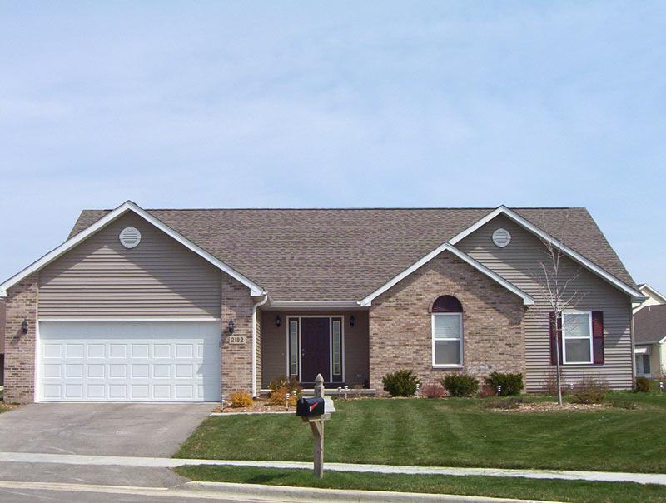
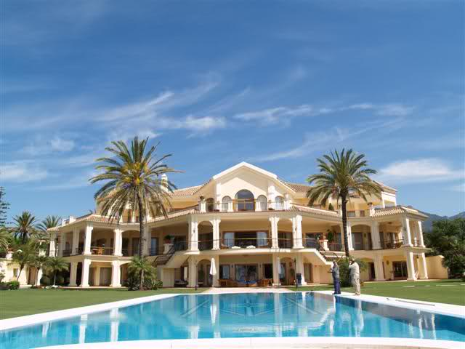
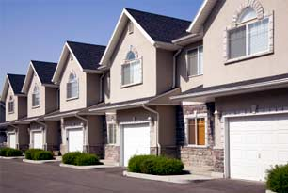
Homeowner’s Markets
Allied, American Modern, Arrowhead, Chubb, Foremost, Kemper, Lloyds, Mercury, MetLife, NatGen Premier, Northfield, Progressive, Safeco, Stillwater, Travelers, and multiple surplus lines carriers.

Slide 12
Other Lines of Business for Homeowners
Fine Arts Floater = Jewelry or Schedule Property.
Earthquake = CEA, Insurance Company or Stand Alone Earthquake (ICAT, GeoVera, ) markets.
Flood Insurance – FEMA or Private
Umbrella

Slide 13
What is not covered?
Earthquakes
Mold
Flood
Backup of Sewers
Certain high valued items have sub-limits – jewelry, guns, furs, silverware.
Maintenance and Repair

Slide 14
Referral Program
When we write the insurance policy for someone you refer to us (and they tell us your name) we will send you either:
1) The Ultimate Movie Experience package with 2 tickets and concession cash, or
2) a Gift Card for the same value.

